Slide 1

Title of Project<<College Information Chatbot>>
JSPM’s
Rajarshi Shahu College of Engineering, Tathawade, Pune
(An Empower Autonomous Institute under Savitribai Phule Pune University)
Department of Computer Science and Business Systems
Artificial Intelligence Mini Project
AY-2025-26
Student Name:
1.Sanjana Chavan (RBT23ME138)
2.Neeta Chavan (RBT23ME178)
Faculty Name:

Slide 2
Introduction
Objective of the Project:
The objective of this project is to develop a user-friendly College Information Chatbot that can answer common student queries related to courses, departments, fees, admissions, and events using Natural Language Processing and the OpenAI API.
Scope:
The chatbot can be used on college websites to:
Assist students 24/7 with instant responses
Reduce workload on administration staff
Improve user experience for new applicants
Provide accurate and updated college information
Mapping With SDG Goal:(Provide Name of SDG goal to Which project Maps)
SDG Goal 4 – Quality EducationThis project promotes accessible and inclusive education information for students.
Key Features:
Answers FAQs like courses, fees, admissions, departments, events
Uses AI (OpenAI API) to generate smart, human-like answers
Simple & interactive chat interface using HTML, CSS, JavaScript
Instant response with natural language understanding
Easy to update and integrate with college websites

Slide 3
Algorithm Used
Chosen Algorithm: Natural Language Processing using OpenAI GPT Model
Reason for Selection:
Provides accurate and human-like responses
Handles multiple types of queries intelligently
Requires no manual rule creation
Advantages:
Efficient and intelligent response generation
Easy to implement with frontend technologies
Scalable and adaptable for any college

Slide 4
Module
List of Module( Provide implementation also)
Module | Description | Implementation
UI Module | Chat interface design | HTML & CSS used to create a clean UI for chat display and input box
Communication Module | Sends user message to API and receives response | JavaScript fetch() function and OpenAI HTTP API
Response Handling Module | Displays chatbot messages dynamically | JavaScript DOM manipulation
Knowledge Module | Contains predefined college information and context | System prompt embedded in code for accurate responses

Slide 5
Methodology & Results
1. Problem analysis:
Students often struggle to find correct and quick information regarding college details. A chatbot solves this by providing instant, accurate support.
2. Algorithm design & coding
3. Testing & validation
Tested with frequently asked college queries
Evaluated accuracy, speed, and usability
Enhanced prompts for improved response quality
Create chat interface using HTML/CSS
Connect JavaScript to OpenAI API
Design system prompt for college-related queries
Display smooth user–bot interaction in the browse

Slide 6
Results & Conclusion:
1) The chatbot successfully provides instant and relevant answers to student queries.
2) It reduces the workload on administration staff and enhances student satisfaction.

Slide 7
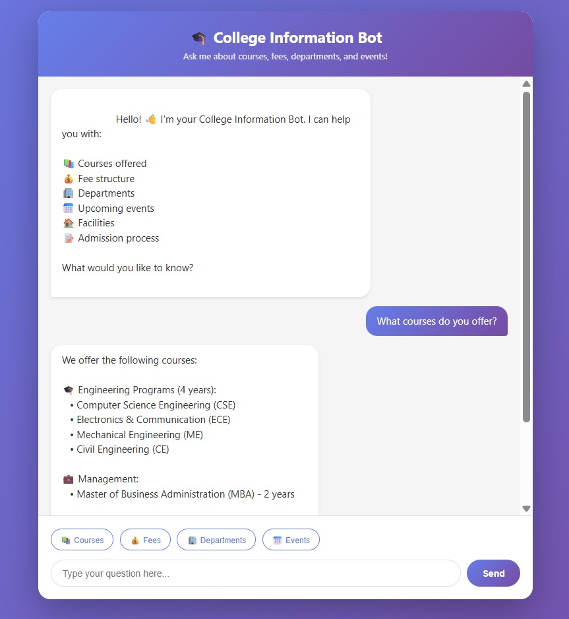
References
OpenAI API Documentation
MDN Web Docs (JavaScript, HTML, CSS)
Sustainable Development Goals (UN)

